Slide 1
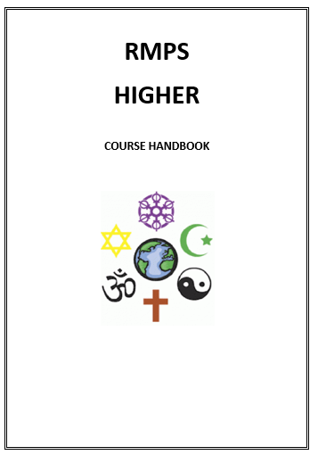
Essay practice:
Explain the relationship between two beliefs you have studied. 10 marks (2017)
Analyse two things 10 mark essay.
Paragraph 1
Explain one of the practices or beliefs using at least three key pieces of KU
Paragraph 2
Explain the second of the practices or beliefs using at least three key pieces of KU
Paragraph 3
Explain how these two link together using two detailed points of analysis.
Beliefs
• beliefs about God
• nature of human beings: yetzer tov; yetzer harah; free will; suffering
• beliefs about Covenant
• judgement; the Messiah; the Messianic Age; Olam Ha’ba

Slide 2

Learning Intention: Today we are focusing on the importance of following the mitzvot.
Success Criteria:
By the end of the lesson I will be able to:
. Understand more about what the mitzvot are and the impact they have on Jewish practice.
. Have analysed the reasons Jews follow these commandments.

Slide 3
Judaism
Beliefs
• beliefs about God
• nature of human beings: yetzer tov; yetzer harah; free will; suffering
• beliefs about Covenant
• judgement; the Messiah; the Messianic Age; Olam Ha’ba
Practices
• living according to the Commandments
• Rosh Hashanah; Yom Kippur
• worship: Shabbat; synagogue

Slide 4

Starter task:
1. Which book of the Torah tells the story of Moses receiving the first 10 commandments?
2. The first five commandments are about a Jews relationship with God, what are the second five focused on?
3. How many mitzvot are there?
4. Which mitvot are the most important?

Slide 5
Starter task:
1. Exodus
2. Relationships with others
3. 613
4. All of them!

Slide 6
Living according to the commandments.
But what’s the point?

Slide 7

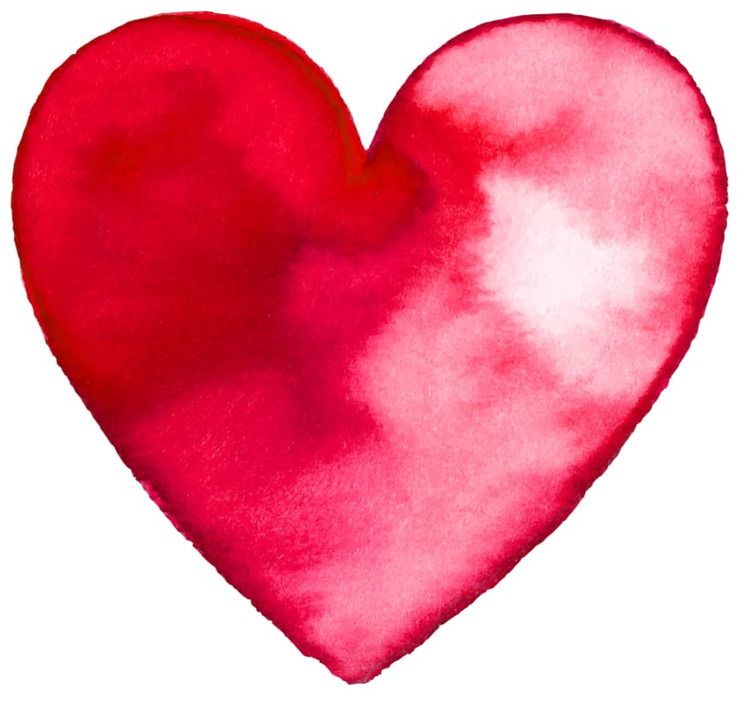
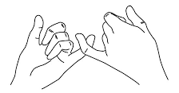
6.10.22 7 reasons Jews follow the commandments
1. It brings them closer to God and shows their love for him.
By obeying the Torah’s instructions on how to
live their life they become more aware of God’s
love and care for them.
2. It is part of the covenantal relationship with God.
The Jewish promise to obey God is expressed in the covenant made with God at Mount Sinai. Here, God promised to enter into a long-term relationship with the children of Israel. Following the mitzvot shows this covenant in action.

Slide 8
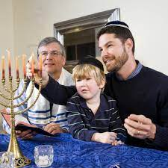
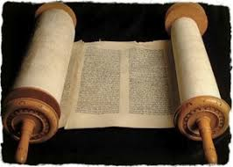

3. It keeps Jewish traditions alive.
Remember Judaism is as much about culture, family and tradition
as it is spirituality. By following the Mitzvot they are showing younger
Jews how things are done and keeping the rituals alive. These traditions embrace all aspects of their lives.
4. It instils good morals and a code for life.
The commandments are full of wisdom and good teachings.
The Torah affirms that God’s commandments are ethical and moral because God is a moral God, and it explains that the commandments help set for people the true standard of morality.

Slide 9
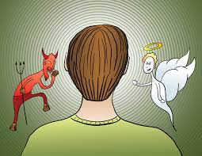
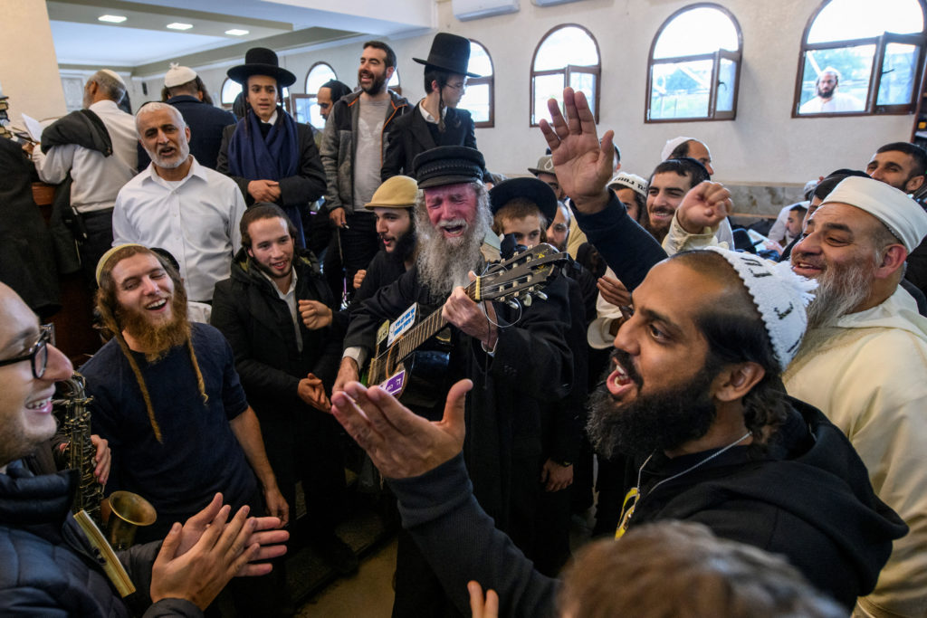
5. Following the Mitzvot helps Jews to balances their YH & YT.
By obeying all of God’s laws they are encouraging
the yetzer tov side of their personality and keeping
the hara side at bay.
It also shows they are using their free will correctly.
6. It brings a sense of togetherness and community.
When everybody is practicing the same things
and trying to follow the commandments as best
they can they feel a sense of unity and
understanding that few others understand.

Slide 10
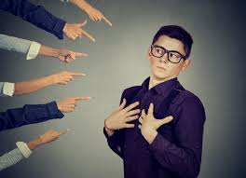
7. The Commandments are a way to become an extraordinary and holy people.
The Hebrew word for “holy” is kadosh, which literally means, “set apart” or “like no other.”
The Torah states that in obeying the mitzvot, the Jewish people become a nation that is unique and set apart from all the other nations in the world.

Slide 11
Looking back at your table can you see the link between the Mitzvot you researched and the purposes we have explored?
Lets discuss this.
Mitzvot | Book of Torah (source) | Explain | Impact on Jew today

Slide 12
When talking about the commandments the SQA focuses on one of these four ideas…..
Purpose
Relevance
Significance
Challenges
Class task: Working together lets consider 5 points for each of these evaluative essay stems.

Slide 13
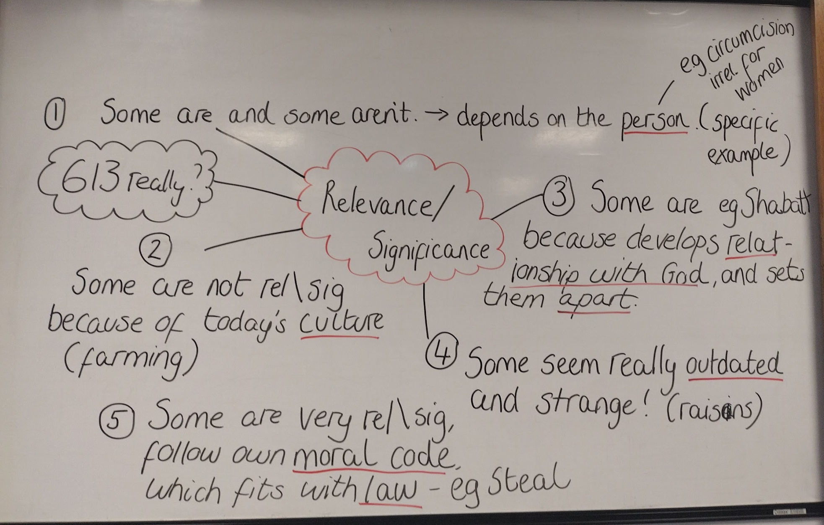

Slide 14
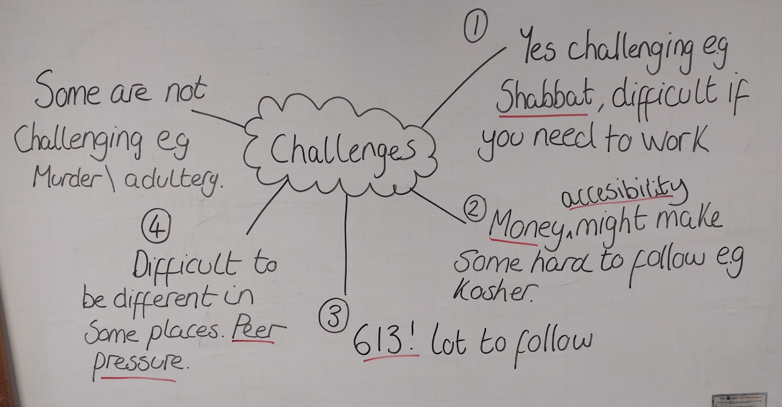

Slide 15
Essay:
Evaluate the relevance of living according to the commandments
20 marks.
Homework
Due: 31st October
(2nd Monday after the holidays.)

Slide 16
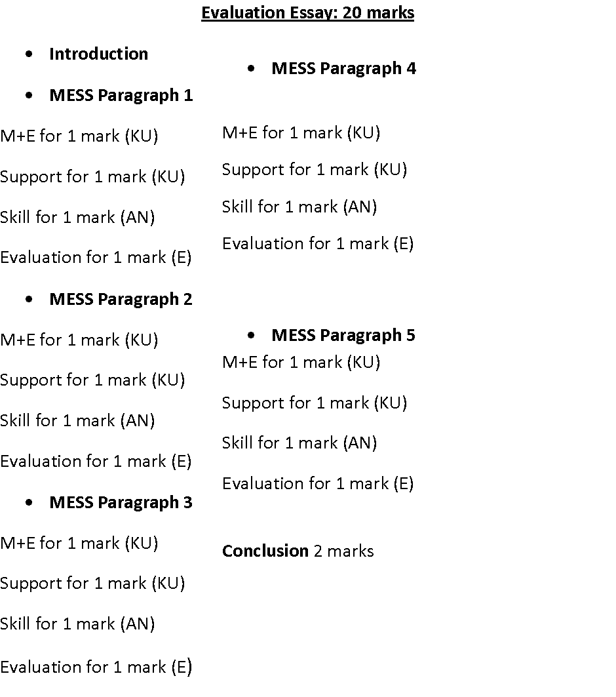
Evaluate the relevance of living according to the commandments 20 marks.
MESSY
Make a statement
Explain it
Support it with evidence/example
Skill (analysis)
Your opinion (evaluation)

